Slide 1


GRDI-AMR-One-Health E. coli Data Curation Workshop
Presented by the Metadata WG
Aug 28 2025

Slide 2
Agenda
Background & instruction period (~1hr)
Data standard goals and design principles (why we’re using this)
Harmonization solutions (what it can do)
DataHarmonizer demo
Worked examples
Tips & tricks (FAQ and considerations for curation)
Work period (~1hr)

Slide 3
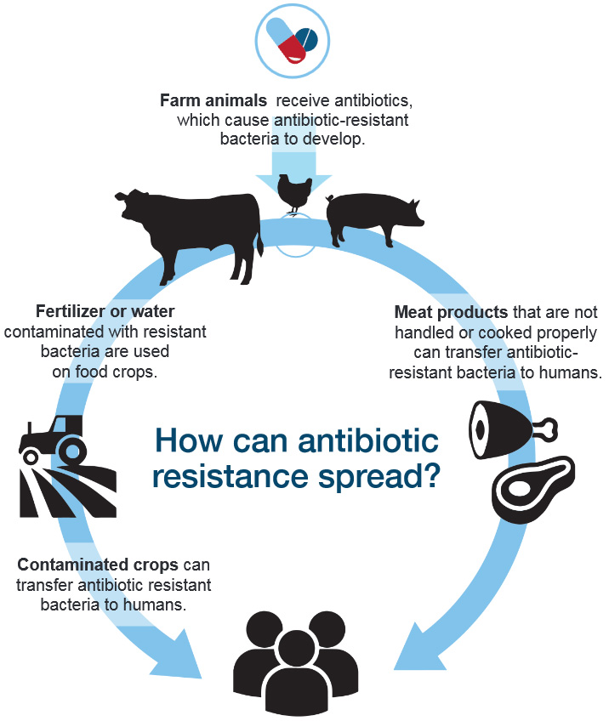
GRDI-AMR standard: Integration/Harmonization of One Health Antimicrobial Resistance (AMR) Genomics Data
GRDI-AMR: Genomics and Research Development Initiative to support Canada’s federal AMR action plan
Partners: Federal departments & agencies (PHAC, CFIA, AAFC, ECCC, DFO, HC), >15 universities,
Ag & Enviro Networks
Challenge: integrate data across
sectors (systems)
commodities (food), environments (terrestrial & aquatic), hosts (humans, animals)
sampling strategies
methods
https://grdi.canada.ca/en/projects/antimicrobial-resistance-2-amr2-project

Slide 4
Goal: Create a data standard that will…
Improve consistency and completeness of contextual data (quality control)
Streamline data sharing (interoperability)
Enable better data integration (usability)
Reduce need for time/resource-intensive data cleaning (efficiency)

Slide 5
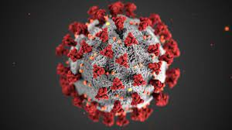
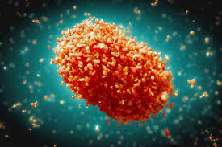
Design principles: Modular, interoperable data standard design
Modular framework and core content (ISO 23418:22)
Thematic Modules
Database identifiers
Sample collection and processing
Host information
Environmental conditions & measurements
Sequencing methods
Bioinformatics and quality control metrics
AMR phenotypic testing
Risk assessment information
Pathogen diagnostic testing details
Provenance and attribution
Modules populated with fields/terms from community-driven ontologies + existing standards (NCBI antibiogram)
Putting standards into practice:
Tooling
Curation SOP
Reference guides
Worked examples
Decision tree (coming soon)
Training videos (coming soon)
Framework already implemented by PHAC for:
https://github.com/cidgoh/GRDI_AMR_One_Health
SARS-CoV-2
MPXV

Slide 6



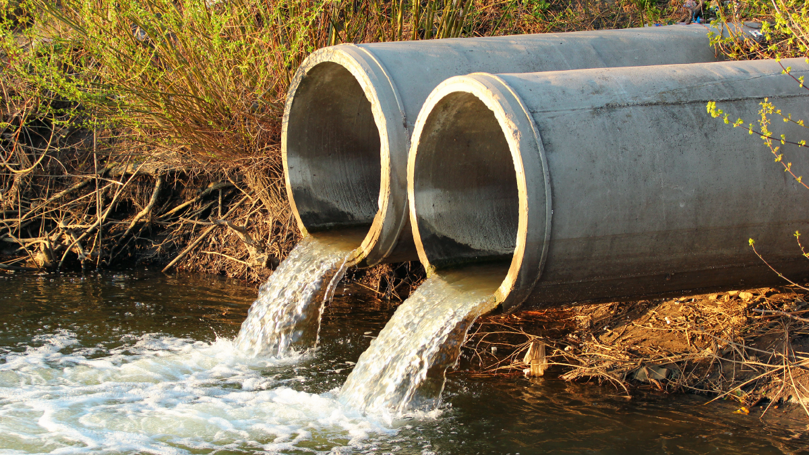
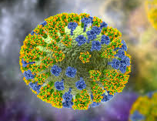

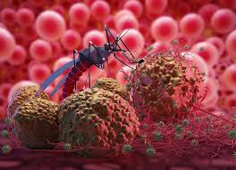
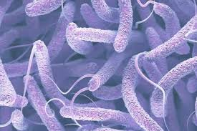

Growing ecosystem of interoperable specifications
SARS-CoV-2
MPXV
Wastewater
Highly Pathogenic Avian Influenza
One Health AMR
Vector borne Diseases
Malaria
Cholera
*AMR detection (hAMRonization)
*Quality control (QC tags, QC metrics)
*Microbial typing specification
*What-Is-A-Sample rules/guidance
*Bioinformatics Interoperability standards

Slide 7
Harmonization challenges the standard solves
Chains of custody
Attribution (sample collection, isolation, characterization, seq, submission)
Identifier tracking
Sample Descriptions
Hosts (scientific, common, production names)
Anatomical parts/materials
Environmental sites/materials
Collection devices/methods
Experimental Design
Sampling strategies
Sample plans
Longitudinal/continuous/point sampling
Specimen processing
Presampling activities
Experimental interventions
Controls and replicates
Sequencing assays/techniques
WGS, Amplicon sequencing, Metagenomics
Bioinformatics
Software, methods, reference databases/genomes, versions
Risk assessment
Prevalence (denominators)
Available data types
And more….!
Improves clarity and structure for humans & computers
Manuscripts with lots of worked examples!

Slide 8
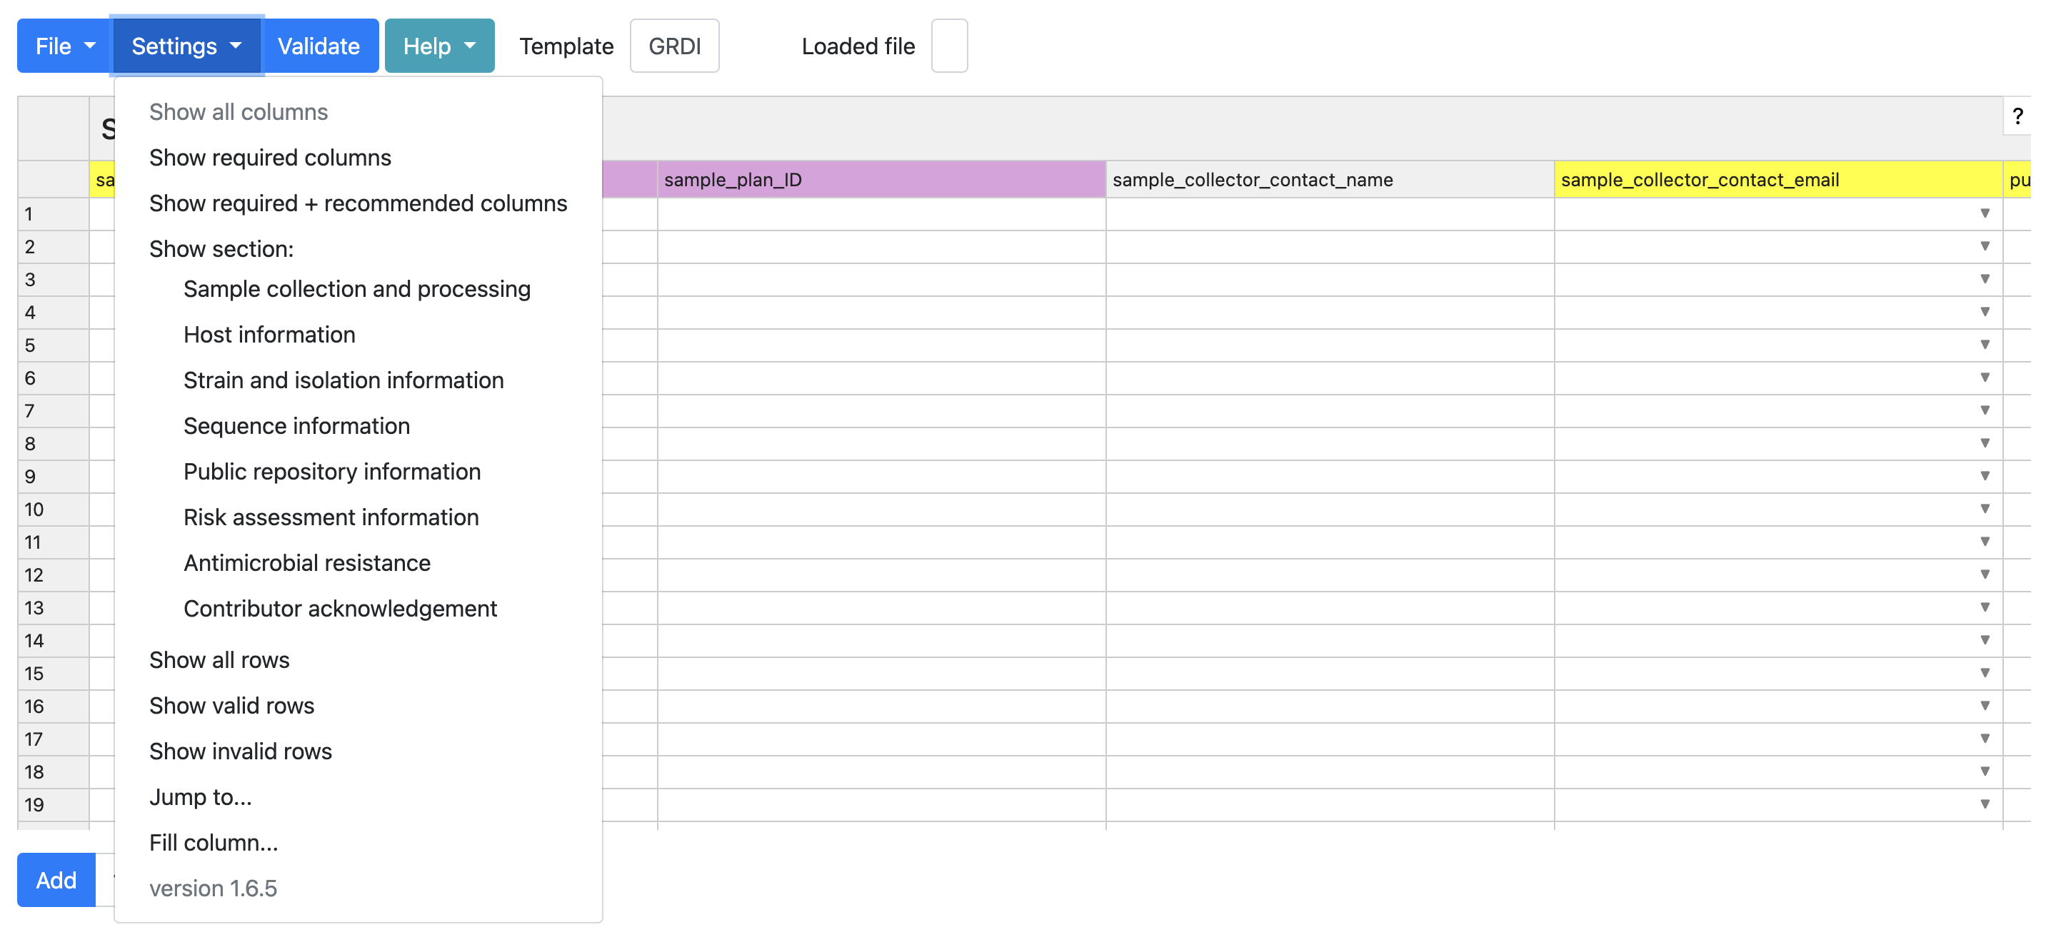
Tooling: DataHarmonizer enables standardized data entry and validation.
Tool for data entry and validation developed for pandemic data harmonization
Spreadsheet-style text editor application
Colour-coding, picklists, curation features, validation
Guidance, curation SOP, training
Validate
(errors or missing info)
Double click on field labels for guidance on how to fill them
View all fields
View required fields
Move to desired field
Learn your way around the system
*Data upload format: xlsx, xls, tsv and csv
Save
Open existing file
Export to chosen format
https://github.com/cidgoh/pathogen-genomics-package
8

Slide 9
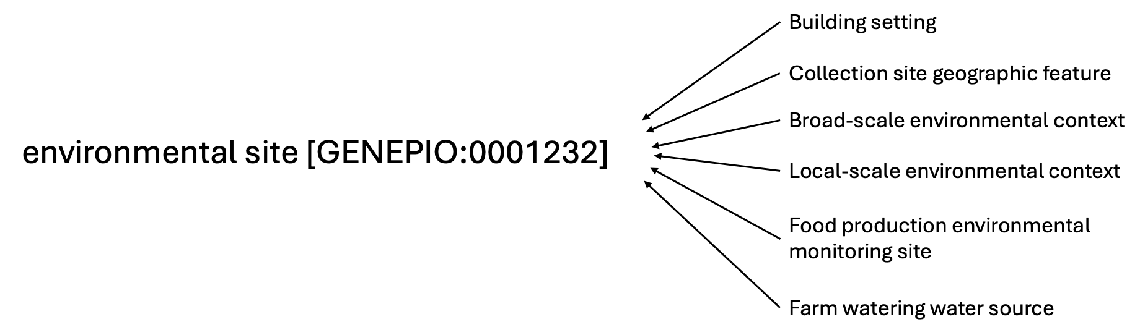
Automated Transformation: Easier conversions between formats
Data needs to move. No one standard to rule them all. Avoid manual restructuring!
Ontology-based approach enables mapping of concepts; creates interoperability:
Canada
USA
International exchange: B2B2B (gold standard contextual data); USA; UK; Uganda; NCBI
Canadian exchange: Canadian Integrated Program for Antimicrobial Resistance Surveillance (CIPARS)
Tooling: DataHarmonizer!
9

Slide 10
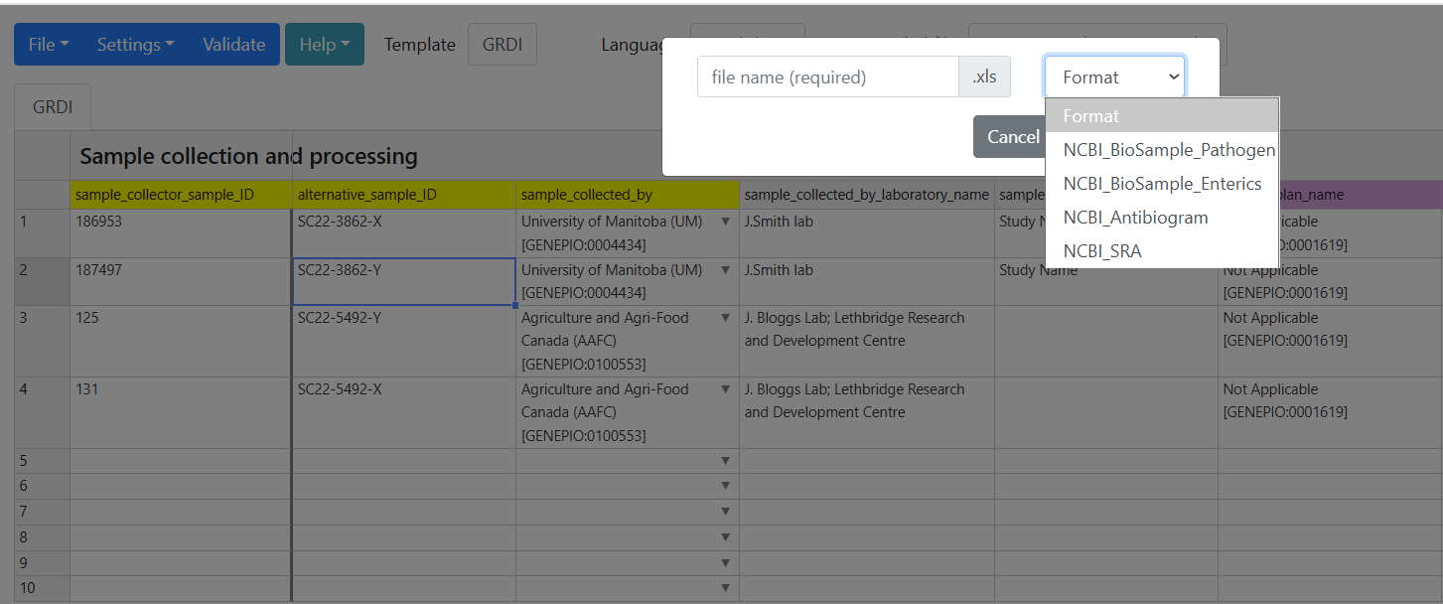
Data transformation is required for different downstream destinations of data.
Enter data once, export in different submission formats i.e. NCBI Pathogen package, NCBI One Health Enterics, NCBI SRA, NCBI Antibiogram
Enter data once, export for different uses!
Get the latest version here: https://github.com/cidgoh/pathogen-genomics-package
MGen, 2022: https://www.microbiologyresearch.org/content/journal/mgen/10.1099/mgen.0.000908

Slide 11
Resources
1. GRDI-AMR Standard (design principles):
The broom of the system: a harmonized contextual data specification for One Health AMR pathogen genomic surveillance (2024), OSF Preprints https://osf.io/preprints/osf/xbf4t_v1
2. Implementation:
Crossing the streams: improving data quality and integration across the One Health genomics continuum with data standards and implementation strategies (2025), Can J Microbiol. https://cdnsciencepub.com/doi/10.1139/cjm-2024-0203
3. GitHub: https://github.com/cidgoh/GRDI_AMR_One_Health

Slide 12
DEMO!

Slide 13
WORKED EXAMPLES!

Slide 14
Scenario 1: FOOD (Meat)
A sample of frozen ground beef was obtained from a retail environment on Sept 15 2019.
The sample was collected by CFIA (sample ID ABC123) as part of its routine Ontario retail surveillance (sample plan “search-and-destroy2019”) and later shared with PHAC (sample ID B1234-a1).
The sample was found to contain Escherichia coli via microbiological isolation and PCR testing (isolate ID badbug444) conducted at PHAC and will be sequenced as part of the GRDI by PHAC.
14

Slide 15
Scenario 1: Food (Meat)
Sample collection and processing
specimen_collector_sample_ID: ABC123
sample_collected_by: Canadian Food Inspection Agency (CFIA) [GENEPIO:0100552]
alternative_sample_ID: B1234-a1
sample_collector_contact_email: meatlab@cfia.ca
sample_plan_name: search-and-destroy2019
purpose_of_sampling: Surveillance [GENEPIO:0100004]
sample_collection_date: 2019-09-15
sample_collection_date_precision: day [UO:0000033]
geo_loc name (country): Canada [GAZ:00002560]
geo_loc name (state/province/territory): Ontario [GAZ:00002563]
food_product: Beef (ground or minced) [FOODON:00001282]
food_product_properties: Food (frozen) [FOODON:03302148]
animal_source_of_food: Cow [NCBITaxon:9913]
environmental_site: Retail environment [ENVO:01001448]
Strain and isolate information
organism: Escherichia coli [NCBITaxon:561]
isolate_ID: badbug444
isolated_by: Public Health Agency of Canada (PHAC) [GENEPIO:0100551]
taxonomic_identification_process: PCR assay [OBI:00002740]

Slide 16
Scenario 2: FOOD (Produce)
A sample of water from rinsed lettuce was obtained in BC in 2020. The lettuce had been shipped from the US.
The lettuce was involved in an outbreak and the sample was assigned an identifier by PHAC (sample ID P5677-jkwncjwnc).
The sample was found to contain Escherichia coli serotype O157:H7 via traditional serotyping (isolate ID coli8352835) and was sequenced as part of the GRDI by PHAC (IRIDA ID GRDI_LL_12345, IRIDA Project ID 666, contact Philomena.cunk@phac.ca) using an Illumina HiSeq 4000.
MICs for a Sensititre 123 (broth dilution) drug panel are available (SIR phenotypes interpreted using CLSI M100 standard).
16

Slide 17
Scenario 2: Food (Produce)
Sample collection and processing
specimen_collector_sample_ID: P5677-jkwncjwnc
sample_collected_by: Public Health Agency of Canada (PHAC) [GENEPIO:0100551]
sample_collector_contact_email: Missing [GENEPIO:0001618]
purpose_of_sampling: Cluster/Outbreak investigation [GENEPIO:0100001]
sample_collection_date: 2020
geo_loc name (country): Canada [GAZ:00002560]
geo_loc name (state/province/territory): British Columbia [GAZ:00002562]
food_product_origin geo_loc name (country): United States of America [GAZ:00002459]
environmental_material: Water [CHEBI:15377]
collection_method: Rinsing for specimen collection [GENEPIO_0002116]
food_product: Lettuce head (whole or parts) [FOODON:03000239]
Strain and isolate information
organism: Escherichia coli [NCBITaxon:561]
serovar: O157:H7
serotyping method: Traditional serotyping
isolate_ID: coli8352835
isolated_by: Public Health Agency of Canada (PHAC) [GENEPIO:0100551]
taxonomic_identification_process: Whole genome sequencing assay [OBI:0002117]

Slide 18
Scenario 2: Food (Produce)
Sequencing Information
sequenced_by: Public Health Agency of Canada (PHAC) [GENEPIO:0100551]
sequenced_by_contact_email: Philomena.cunk@phac.ca
purpose_of_sequencing: Research [GENEPIO:0100003]
sequencing_instrument: Illumina HiSeq 4000 [GENEPIO:0100119]
IRIDA_isolate_ID: GRDI_LL_12345
IRIDA_project_ID: 666
AMR Testing Information
AMR_testing_by: Public Health Agency of Canada (PHAC) [GENEPIO:0100551]
AMR_testing_by_contact_name: Missing [GENEPIO:0001618]
AMR_testing_by_contact_email: Missing [GENEPIO:0001618]
AMR_laboratory_typing_platform: Sensititre [ARO:3004402]
AMR_laboratory_typing_method: Broth dilution [ARO:3004397]
gentamicin_measurement: 64
gentamicin_measurement_unit: ug/mL
gentamicin_measurement_sign: greater than or equal to (>=) [GENEPIO:0001005]
gentamicin_susceptible_breakpoint: 4
gentamicin_resistance_breakpoint: 32
gentamicin_resistance_phenotype: Resistant antimicrobial phenotype [ARO:3004301]
gentamicin_testing_standard: Clinical Laboratory and Standards Institute (CLSI) [ARO:3004366]
gentamicin_testing_standard_version: M100
18

Slide 19
Scenario 3: Environmental (Abx pre-treatment)
The AAFC performed a field experiment examining AMR spread on pig farms in the prairies via aerosolization.
Feed was pre-treated with antibiotic X (400ppm) and distributed to animals, and the air was sampled (sample ID: QWERTY888) by leaving an agar dish (MacConkey) open for 3hrs on March 3 2021.
E. coli isolates are currently being selected for sequencing as part of the GRDI.

Slide 20
Scenario 3: Environment (Abx Pre-treatment)
Sample collection and processing
specimen_collector_sample_ID: QWERTY888
sample_collected_by: Agriculture and Agri-Food Canada (AAFC) [GENEPIO:0100553]
sample_collector_contact_email: Missing [GENEPIO:0001618]
purpose_of_sampling: Field experiment [GENEPIO:0100550]
sample_collection_date: 2021-03-21
geo_loc name (country): Canada [GAZ:00002560]
geo_loc name (state/province/territory): Prairie region (Canada) [wikidata:Q1364746]
original_sample_description: air - MacConkey II plate open 3 hours (pig farm)
environmental_material: Air [ENVO:00002005]
environmental_site: Farm [ENVO:00000078]
animal_or_plant_population: Pig [NCBITaxon:9823]
collection_device: Culture plate [GENEPIO:0004318]
Stain and isolate information
organism: Escherichia coli [NCBITaxon:561]
isolated_by: Agriculture and Agri-Food Canada (AAFC) [GENEPIO:0100553]
Risk assessment
experimental_intervention: Addition of substances to food/water [GENEPIO:0100536];Antimicrobial pre-treatment [GENEPIO:0100537]
experimental_intervention_details: feed supplemented with 440 ppm antibiotic X

Slide 21
Scenario 4: Host (certified practices)
The AAFC performed a survey study examining pig husbandry practices on AMR spread in abattoirs in Quebec.
A fecal sample (single source; sample ID AAFC-PP-456701b) was obtained from a pig in an abattoir on August 25 2025. The pig had been raised on a farm that was certified for implementing the AGRO-GENTLEMENPIGS husbandry practices.
E. coli isolates are currently being sequenced as part of the GRDI.
The study confirmed 47/1000 E.coli isolates tested positive for the same AMR determinant at the harvest stage of production (abattoir) when husbandry practices were used, compared to 89/1000 positive isolates on uncertified farms.

Slide 22
Scenario 4: Host (certified practices)
Sample collection and processing
specimen_collector_sample_ID: AAFC-PP-456701b
sample_collected_by: Agriculture and Agri-Food Canada (AAFC) [GENEPIO:0100553]
sample_collector_contact_email: Missing [GENEPIO:0001618]
purpose_of_sampling: Survey study [GENEPIO:0100582]
sample_collection_date: 2025-08-25
geo_loc name (country): Canada [GAZ:00002560]
geo_loc name (state/province/territory): Quebec [GAZ:00002569]
original_sample_description: pig feces, abattoir, AGRO-GENTLEMENPIGS
body_product: Feces [UBERON:0001988]
environmental_site: Abattoir [ENVO:01000925]
specimen_processing: Isolated from single source [OBI:0002079]
Stain and isolate information
organism: Escherichia coli [NCBITaxon:561]
isolated_by: Agriculture and Agri-Food Canada (AAFC) [GENEPIO:0100553]
Risk assessment
experimental_intervention: Certified animal husbandry practices [GENEPIO:0100538]
experimental_intervention_details: testing effects of animal husbandry practices - AGRO-GENTLEMENPIGS
prevalence_metrics: 47/1000 E.coli isolates tested positive for the same AMR determinant
prevalence_metrics_details: 89/1000 positive isolates on uncertified farms
stage_of_production: Abattoir [ENVO:01000925]
Host information
host_(scientific_name): Sus scrofa domesticus [NCBITaxon:9825]
host_(common_name): Pig [NCBITaxon:9823]

Slide 23
Scenario 5: Environmental (manure)
The AAFC performed a research project examining the prevalence and diversity of AMR determinants in manure on conventional dairy farms in Saskatchewan.
A sample of manure (sample ID AAFC-MF-8648045) was obtained from an animal pen on a dairy farm in early 2025. The farm is part of a dairy production stream, and the lab also has feed history and Vitek microbial profile data available.
E. coli isolates are currently being selected for sequencing as part of the GRDI.

Slide 24
Scenario 5: Environmental (manure)
Sample collection and processing
specimen_collector_sample_ID: AAFC-PP-456701b
sample_collected_by: Agriculture and Agri-Food Canada (AAFC) [GENEPIO:0100553]
sample_collector_contact_email: Missing [GENEPIO:0001618]
purpose_of_sampling: Survey study [GENEPIO:0100582]
presampling activity: Conventional farming practices [GENEPIO:0100895]
sample_collection_date: 2025
geo_loc name (country): Canada [GAZ:00002560]
geo_loc name (state/province/territory): Saskatchewan [GAZ:00002564]
original_sample_description: manure from a conventional dairy farm, animal pen
food_product_production_stream: Milk production stream [FOODON:03000459]
Sample collection and processing (cont’d)
environmental_site: Dairy farm [ENVO:03501416];Animal pen [ENVO:03501387]
environmental_material: Animal manure [AGRO:00000079]
available_data_types: Feed history [GENEPIO:0100704];Microbiological identification (ViTek) [GENEPIO:0100721]
Stain and isolate information
organism: Escherichia coli [NCBITaxon:561]
isolated_by: Agriculture and Agri-Food Canada (AAFC) [GENEPIO:0100553]

Slide 25
Scenario 6: Environmental (surface water)
The ECCC performed a research project examining the prevalence and diversity of AMR determinants in surface water..
Five water samples were collected from different locations in Lake Ontario and pooled (sample ID ECCC-LO-99666) on a sunny day (July 23 2024), at a depth of 1m. It had rained prior to sample collection (5cm).
E. coli isolates are currently being selected for sequencing as part of the GRDI.
While most of the sample was used for microbiological testing, some of the water sample (residual sample) is still available and is currently stored at -80C.

Slide 26
Scenario 5: Environmental (surface water)
Sample collection and processing
specimen_collector_sample_ID: ECCC-LO-99666
sample_collected_by: Environment and Climate Change Canada (ECCC) [GENEPIO:0100555]
sample_collector_contact_email: Missing [GENEPIO:0001618]
purpose_of_sampling: Research [GENEPIO:0100003]
sample_collection_date: 2024-07-23
geo_loc name (country): Canada [GAZ:00002560]
geo_loc name (state/province/territory): Ontario [GAZ:00002563]
geo_loc_name (site): Lake Ontario
original_sample_description: surface water, pooled
specimen_processing: Samples pooled [OBI:0600016]
specimen_processing_details: 5 samples from different sites in the lake pooled
environmental_site: Lake [ENVO:00000020]
environmental_material: Surface water [ENVO:00002042]
residual_sample_status: Residual sample remaining (some sample left) [GENEPIO:0101087]
Environmental conditions and measurements
sampling_weather_conditions: Sunny/Clear [ENVO:03501421]
water_depth: 1
water_depth_units: meter (m) [UO:0000008]
presampling_weather_conditions: Rain [ENVO:01001564]
precipitation_measurement_value: 5
precipitation_measurement_unit: centimeter (cm) [UO:0000015]
Stain and isolate information
organism: Escherichia coli [NCBITaxon:561]
isolated_by: Environment and Climate Change Canada (ECCC) [GENEPIO:0100555]

Slide 27
FAQ/Troubleshooting
1. What is a good identifier?
Nope:1a, 2b, 1ΔgyrA
Yep: PHAC-XY-12345
Make them complex, avoid identifiable info, see “Best Practices for Sample and Isolate Identifiers” Guidance doc
2. When does an animal become food? (hosts vs food products)
When they enter the food production system post-carcass.
Carcasses are considered deceased hosts.
Processed animals are considered food products (chops, ground meat, ready meals)
3. What if a food product is produced in one place and sampled in another?
geo_loc fields for points of sampling (“geo_loc_name (country)”)
For origins:
food_product_origin_geo_loc_name (country)
host_origin_geo_loc_name (country)
4. What’s the difference between “anatomical part”, “anatomical material” and “body product”?
Anatomical parts – body parts (identifiable in an anatomy textbook – answers “where”)
Anatomical materials – substances/materials (e.g. tissue, blood, answers “what”)
Body products – substances excreted/secreted, e.g. feces, vomit, tears, stomach contents, “stuff going out”)

Slide 28
FAQ/Troubleshooting
5. What if we don’t have info for required fields?
Leave blank if you can come back and fill it in later.
Otherwise, provide a null value (Missing, Not collected, Not provided, Not applicable, Restricted access)
6. Why are “purpose of sampling” and “purpose of sequencing” fields required?
Capture sampling strategies which may have biases and limitations. Need to know these for interpretation of data.
7. I see there is a wastewater descriptor in the “environmental material” field, but no stages in the wastewater process (e.g. post grit removal). How do we enter that info?
Use “presampling activity” field.
8. What if we have control samples that are useful for optimization or replicates?
Use “experimental_specimen_role_type” field.
9. What if we have data for samples that have known QC issues, but they could still be useful?
Use the QC tags in the Bioinformatics and QC metrics module.
quality_control_method_name
quality_control_method_version
quality_control_determination
quality_control_issues
quality_control_details

Slide 29
Things to keep in mind
Track identifiers
Provide the most granular information available
Provide information for follow-up and attribution (contact info, provenance, plans/protocols)
Fill in as much of the info that applies to your sample – LEAVE THE REST
Be clear about what you know and you don’t know (missing info, confusing details)
Use the SOP and reference guides
Include organism/isolate information
Make others aware of bias (sampling/sequencing selection motivation, pre-sampling activities, experimental detail)
Methods information is just as important sample information
Use the NTR system if there are terms missing (GitHub repo)
Have questions? Contact Emma Griffiths (ega12@sfu.ca)

Slide 30
Questions?
30

